Slide 1
Azure Storage Tables

Slide 2
What is NoSQL
Validation and schema checks
Performance over consistency
Allowing data to have a structure without enforcing the structure through a Schemas
Allow data to be replicated across many nodes asynchronously

Slide 3
Difference from Relational Databases
Relational
Schemas
Relationships

Slide 4
Types of NoSQL Databases
NoSQL
Key-Value
Document
Column

Slide 5
Azure Storage
Azure
Blob
Table
File

Slide 6
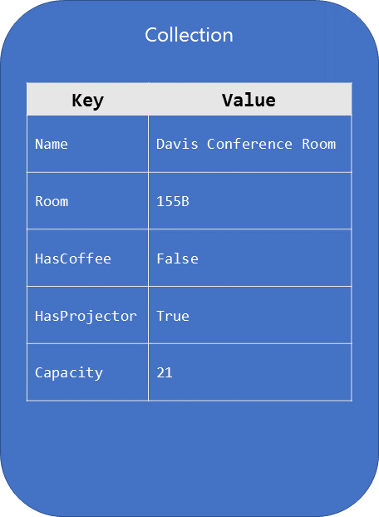
Key-Value

Slide 7
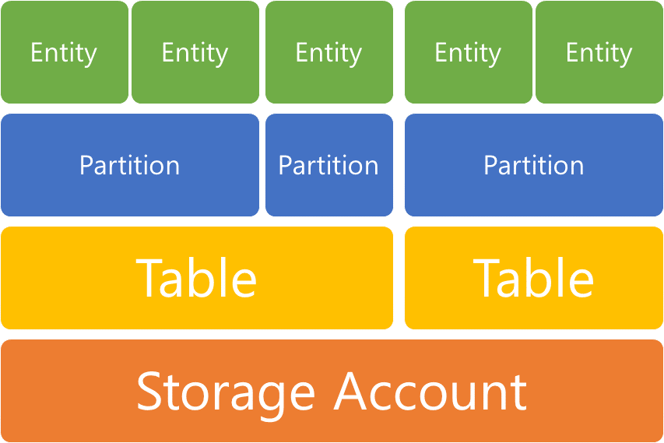
Conceptual model

Slide 8
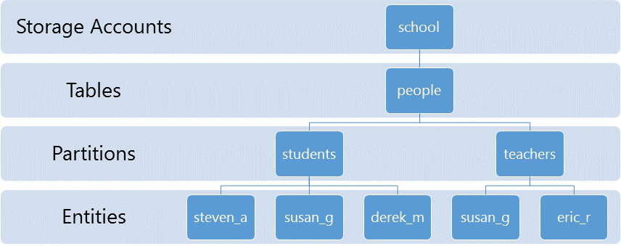
Conceptual model

Slide 9
Quiz
What is the difference between Relational and NoSQL databases?
What is the main idea behind the Key-Value Storage?
What is the purpose of the Partition layer in Table Storage?

Slide 10
Vocabulary

